Slide 1

NAME : A.VIGNESH
NM ID : au412721205057
College : Tagore Engineering College

Slide 2
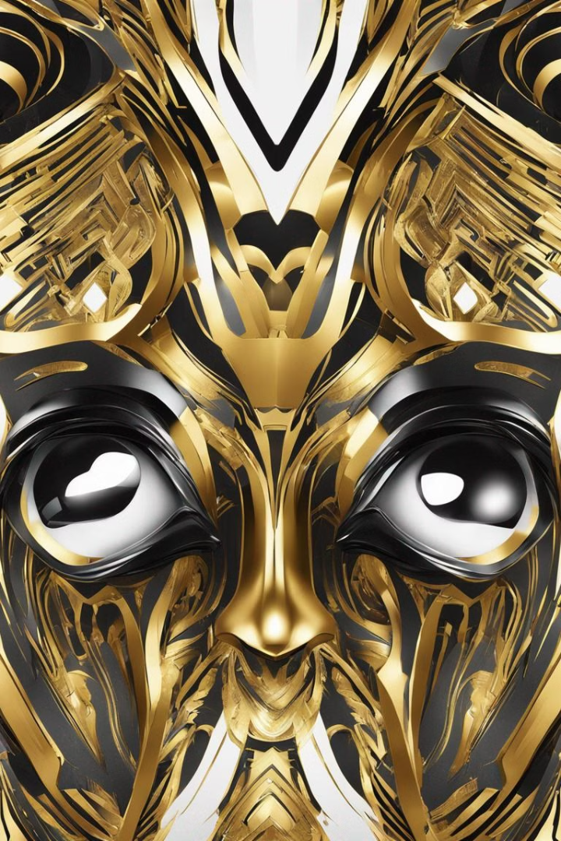
Introduction to Anime Face Generator using GAN
Anime Face Generator using GAN is an innovative project that leverages Generative Adversarial Networks (GANs) to create unique and realistic anime-style faces. GANs are a type of artificial intelligence algorithm used in generative modeling, and they have the ability to produce highly convincing and detailed images. This project aims to explore the intersection of technology and art by developing an advanced system for generating anime character portraits. By harnessing the power of GANs, this project seeks to offer a cutting-edge solution for artists, creators, and enthusiasts in the anime community.

Slide 3

Agenda
1
Research & Development
Exploring the capabilities of GANs in image generation and processing.
2
Design & Implementation
Creating a user-friendly interface for generating and customizing anime faces.
3
Testing & Iteration
Conducting thorough testing and refinement to ensure the quality and reliability of generated faces.

Slide 4

Problem statement
Variety and Customization
Fine Details and Realism
User-Friendly Interface
Existing anime character generation tools lack the ability to produce diverse and customizable faces, limiting creative possibilities.
Current solutions struggle to capture fine details and realistic features in generated anime faces, hindering the immersive experience.
Complex user interfaces of available anime face generators pose usability challenges for both amateur and professional users.

Slide 5
Project Overview
Technology
Artistic Expression
Community Impact
The project utilizes advanced machine learning techniques, specifically GANs, to achieve realistic anime face generation.
It aims to empower artists and creators with a tool for expressing their ideas through customized anime character designs.
The project intends to contribute to the anime community by providing a new avenue for character creation and storytelling.

Slide 6
Who are the End user?
1
2
Role-Playing Game (RPG) Developers
3
Anime Fans & Enthusiasts
Anime Artists
Professional and aspiring artists looking to efficiently generate diverse anime character portraits for their projects.
Game developers seeking a comprehensive tool to create and customize anime-style avatars and characters for RPGs.
Enthusiasts interested in exploring and experimenting with anime character creation and customization.

Slide 7
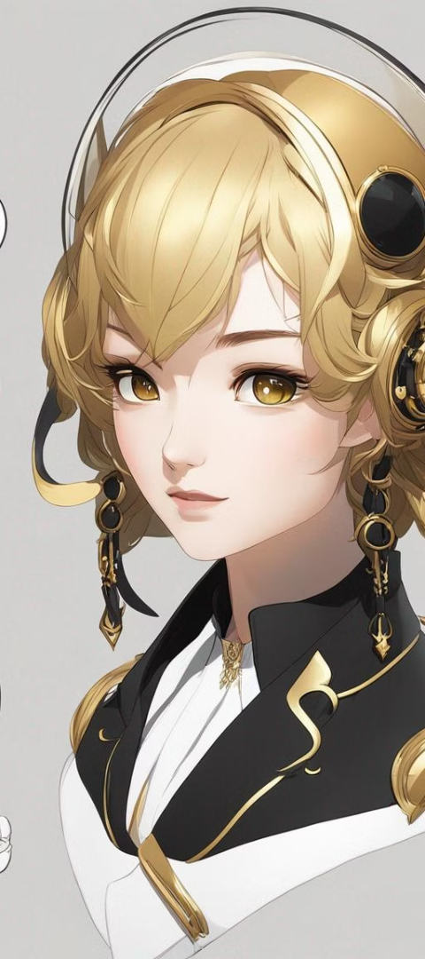



Your solution and its value proposition
Unprecedented Customization
Our solution offers an extensive range of customization options, allowing users to tailor every aspect of the generated anime faces.
Realistic and Immersive
By harnessing the power of GANs, we deliver highly realistic and immersive anime character faces with intricate details.
Intuitive Interface
We prioritize user experience, ensuring our interface is intuitive and accessible to users of all skill levels.

Slide 8



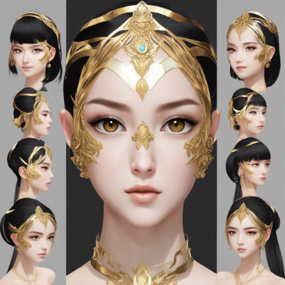
The Wow in your solution
Unmatched Realism
Community Collaboration
Limitless Customization
Our solution sets a new standard for realism in anime face generation, capturing intricate facial features and expressions.
Users can truly unleash their creativity through an extensive array of customizable features and attributes.
We foster a community-driven approach, encouraging collaboration and sharing among anime creators and enthusiasts.

Slide 9
Modeling
GANs
An advanced machine learning model known for its generative capabilities in producing high-quality images.
Facial Recognition
Integrated feature to ensure accurate representation of facial elements, contributing to realism.
User Input
Allowing users to provide specific inputs to tailor the generated anime faces according to their preferences.

Slide 10
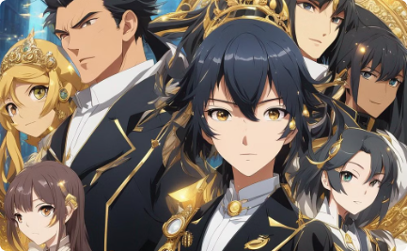
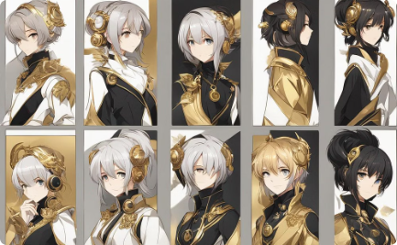
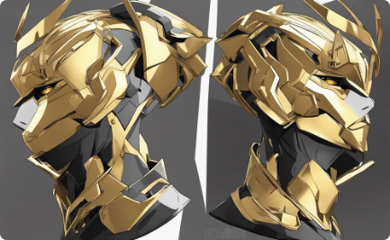
Conclusion
Diverse Characters
User Experience
Community Impact
The result is a vast collection of diverse and unique anime characters with vibrant colors and impressive realism.
Users enjoy an intuitive interface and seamless customization, enhancing their creativity and productivity.
The project makes a significant contribution to the anime community, fostering collaboration and artistic expression.

